Slide 1
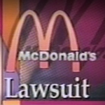
The McDonald’s Hot Coffee Case
https://static01.nyt.com/images/2013/10/21/business/media/retro-report-mcdonalds-still/retro-report-mcdonalds-still-thumbLarge-v4.png
Name:
Tutor:
Course:
Course Code:
Notes:
The case involved Stella Lebeck who got burned by hot coffee after it spilled over her sweatpants. She had bought the coffee at a drivethrough window at McDonalds.

Slide 2
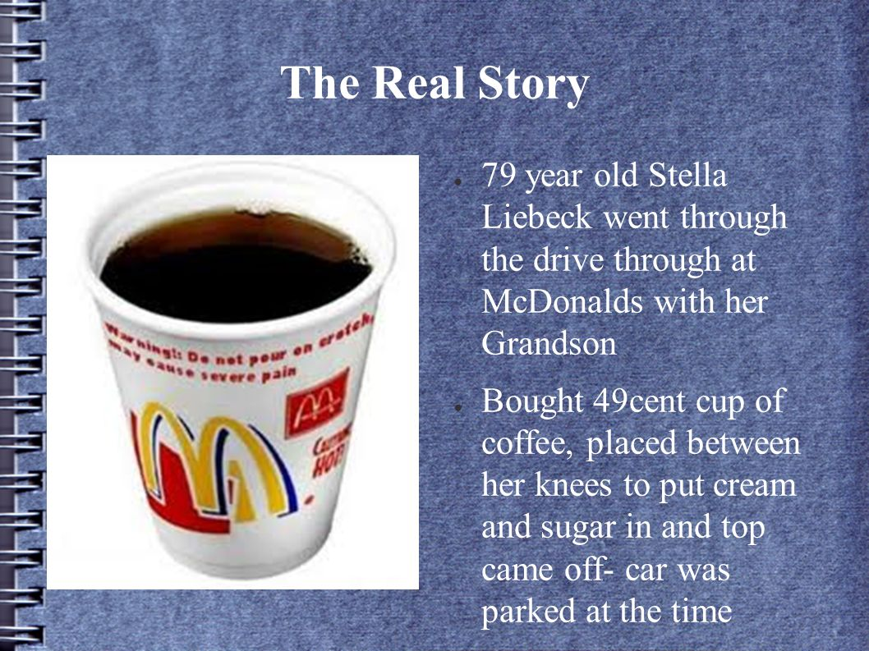
Overview
The case involves Stella Liebeck who was burned by hot coffee.
She bought the hot coffee at a local McDonald’s drive through window.
She was attempting to open the lid.
She placed the coffee between her legs in order to add cream and sugar.
Unluckily the hot coffee spilled onto her laps.
The hot contents were absorbed by sweatpants.
She got severely burned on her thighs, buttocks, groin and genital areas.
https://images.slideplayer.com/42/11317543/slides/slide_5.jpg
Notes:
The case involves 79 year old Stella Liebeck who bought hot coffee at a McDonald’s drive through window (Darryl, 2017). Stella had attempted to open its lid when she had placed the container in between her legs. Unfortunately, the hot content of the coffee container spilled and was absorbed by her sweatpants which ended up burning her thighs, buttocks, groin and genital areas.

Slide 3
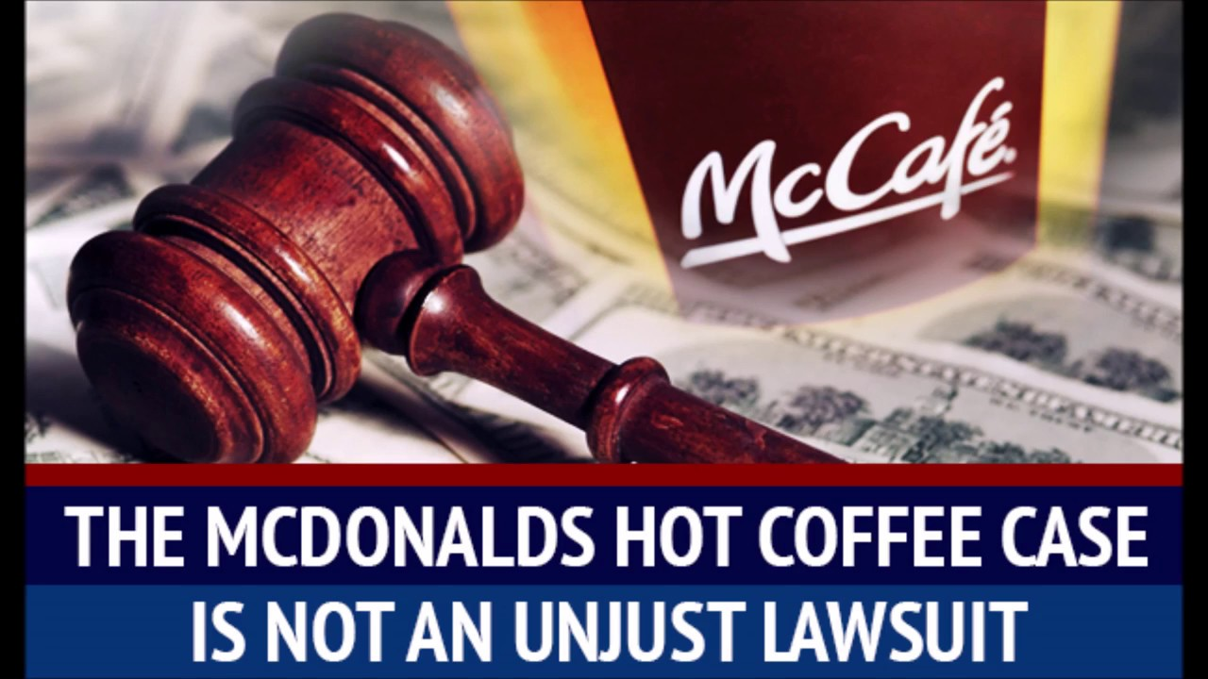
Overview
She was hospitalized for 8 days for treatment of the burns.
She received debridement and local wound care.
The areas which were severely burned received skin grafts coverage.
Stella Liebeck filed a suit against McDonalds
She sought to settle for $20,000 to cater for her medical bills.
McDonalds did not agree to settle the medical bill.
https://i.ytimg.com/vi/ppjPxynnxtM/maxresdefault.jpg
Notes:
The burns were severe that some parts received skin grafts coverage. She filed a case whereby she sought for a settlement of $20,000 (Darryl, 2017). however, McDonalds failed to settle the amount that Ms. Liebeck has asked for.

Slide 4
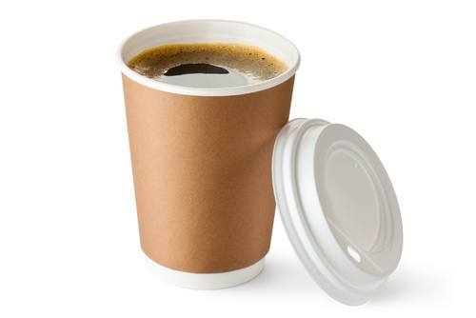
Overview
The litigation phase brought about several interesting facts.
McDonalds had faced more than 700 claims.
The claims involved people who had suffered burns from the coffee
The claims dated between 1982 to 1992.
Some claims involved full-thickness burns.
The claims showed that the company knew of the risk posed by the hot coffee.
https://injuryattorneyflorida.com/wp-content/uploads/2014/03/McDonalds-Hot-Coffee-Case.jpg
Notes:
During the litigation phase, several facts were brought to light. It was found out that the company had received more than 700 claims (Darryl, 2017). The claims involved people who had suffered severe burns similar to those of Ms. Lebeck. Thus, the company was aware of the risk that was posed by the extremely hot coffee served to the customers.

Slide 5
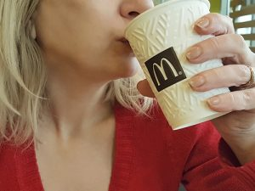
Overview
McDonalds gave in to the claims.
They admitted that they kept the coffee temperature between 180 and 190 degrees Fahrenheit.
They claimed that a consultant had advised them to keep the coffee at that high temperature.
Coffee had the best taste at such high temperatures.
McDonalds claimed that customers consumed the coffee after they got at home or work.
The temperatures could have cooled down by that time.
https://www.californiaaccidentattorneysblog.com/files/2018/02/Depositphotos_176767470_s-2015-300x225.jpg
Notes:
McDonalds agreed that their coffee was hot as it was kept at temperatures between 180 and 190 degrees Fahrenheit (Darryl, 2017). They claimed that they had been advised to maintain a high temperature by a consultant so that the coffee could have the best taste. In addition, they said that most of the customers took the coffee after reaching home and by that time they believed the temperature could have cooled down.

Slide 6
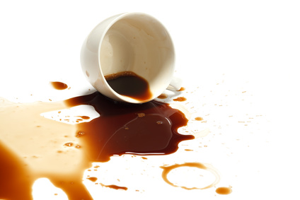
Overview
The company’s later research shown that most customers drank the coffee while in the car.
The company admitted that they never studied the risks linked to high temperature.
It was found out that other shops sold their coffee at temperatures between 135 and 140 degrees.
It was found out that liquids at 180 degrees causes full-thickness burn in two to seven seconds.
Liquids with 155 degrees temperatures would probably not cause such burns.
If the coffee bought by Liebeck was 155 degree it would not have caused severe burns.
https://www.forensisgroup.com/wp-content/uploads/2016/03/product-liability-mc-donald-coffee-forensisgroup.jpg
Notes:
The company later on carried out a research that shown that most of the customers took their coffee while still in the car. It was also found out that, the other coffee shops sold their coffee while at a temperature between 135 and 140 range (Darryl, 2017). Liquids at 155 temperatures could not cause such severe burns.

Slide 7
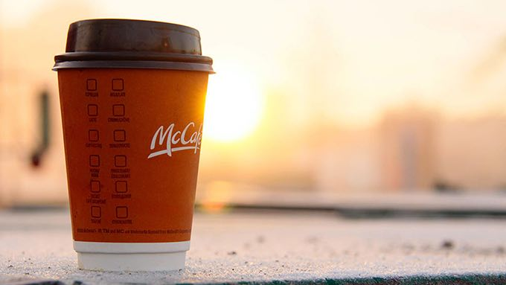
Overview
McDonald's legal team claimed that Ms. Lebeck failed to minimize the chance of injury.
She held the coffee cup between her thighs.
she did not remover her sweatpants immediately upon spilling the coffee.
McDonald’s legal team claimed that the company was going to reduce the coffee temperature.
https://i2.wp.com/consciouslifenews.com/wp-content/uploads/2015/10/mcdonalds-coffee.jpg?ssl=1
Notes:
McDonald’s legal team asserted that if only Ms. Lebeck would have removed her sweatpants, she could not have suffered such burns. In addition, she increased the possibility of being burnt by placing the coffee cup in between her thighs (Darryl, 2017). However, the company agreed to lower the temperature of the coffee.

Slide 8
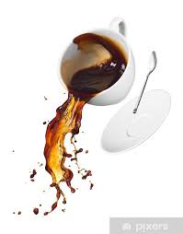
Overview
McDonalds claimed that its customers knew the coffee was hot.
The customers wanted the coffee served under high temperatures.
There was a warning of the content being hot.
The warning was not that visible.
The company admitted to the fact that the warning was not clearly visible.
They also admitted that the customers were not aware of the risk of the high temperatures.
https://encrypted-tbn0.gstatic.com/images?q=tbn%3AANd9GcSIHZdj6sCq3yvFnNtWUzx43lSyK2Nv8yd3LhLrqn_tRNqedXQu&usqp=CAU
Notes:
There was some claims from McDonalds that the customers were aware of the high temperatures of the coffee. In addition, they asserted that they had indicated that the contents were hot. However, McDonalds admitted that the warning was not that visible and that the customers were not aware of the risks of the high temperatures (Darryl, 2017).

Slide 9
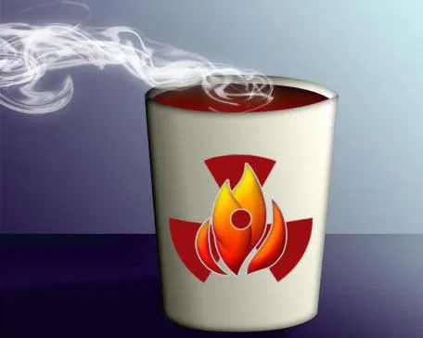
Overview
MacDonald’s quality assurance manager said that the company required the shops to keep the coffee pot temperature that high.
The quality assurance manager admitted that there existed a risk of burn.
The high temperatures could also cause burns to the mouth and throat.
McDonalds had no plans of reducing the coffee temperatures.
https://i1.wp.com/www.openmindsfoundation.org/wp-content/uploads/2017/05/hot-coffee.jpg?resize=456%2C364&ssl=1
Notes:
The quality assurance manager’s testimony finished the company when he asserted that the company required its shops to maintain such a high temperature. He also admitted to the fact that such high temperatures exposed the buyers at a risk of third-degree burns (Darryl, 2017). Despite of all the risks that were associated with the high temperatures, McDonalds had no plans of reducing the temperatures.

Slide 10
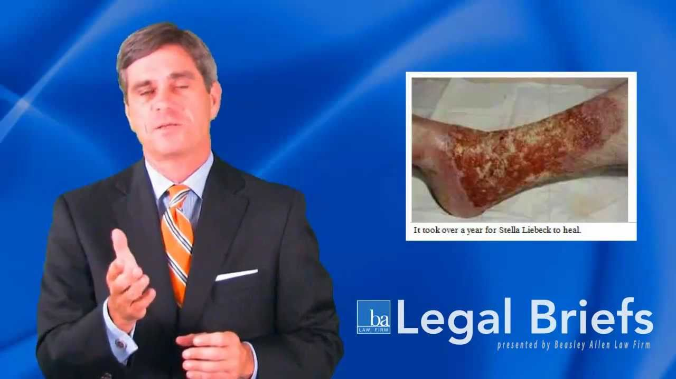
Relevant Kinds of Insurances
Product Liability Insurance
A company that deals with a product or services has to have a product liability insurance.
However, a company has to ensure its product’s safety.
A company picks on every possible measure.
A company looks for ways tom prevent a lawsuit due to damages caused by its products.
The policy has to be tailored to the needs of the product.
https://i.ytimg.com/vi/9rbKywI3ww8/maxresdefault.jpg
Notes:
Product liability insurance is a type of insurance that covers claims that results to lawsuits due to damages caused by a product (Daller, 2015). In the case of McDonalds, the product that caused damages is the hot coffee. It caused full-thickness burns on the thighs, buttocks, groin and genital areas.

Slide 11
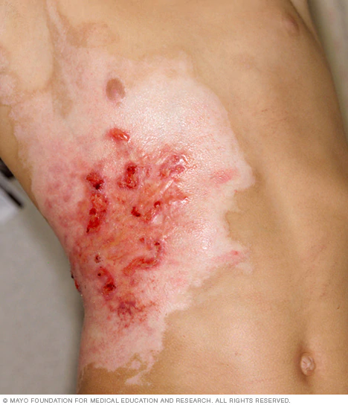
Cont…,
Accident Insurance
Covers for costs linked to an injury during an accident.
It covers bodily damages caused by burns.
The payout amount depends on the degree of severity of the injury.
If burns are less than 10% of your body, the payout is less.
If the burns are third-degree burns, the amount of the payout goes up.
https://www.mayoclinic.org/-/media/kcms/gbs/patient-consumer/images/2013/08/26/10/08/ds01176_im04388_mcdc7_third_degree_burnthu_jpg.jpg
Notes:
There are different types of insurance that are relevant in this case. One of the type of insurances is the accident insurance which covers costs that are connected to an injury during an accident. This kind of insurance covers for damages caused by burns.

Slide 12
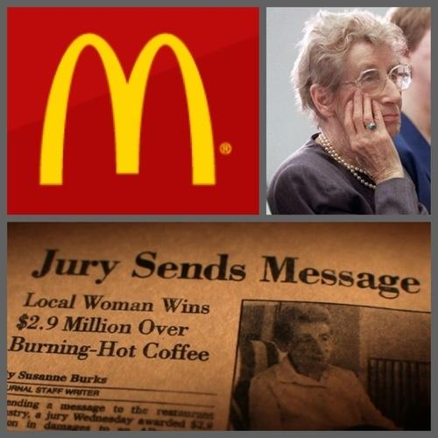
Wrapping up the Case
The Supreme Court concluded that McDonalds was reckless.
The court awarded Ms. Lebeck $480,000 to compensate for the damages.
Later on McDonalds tabled the issue secretly with Ms. Lebeck and settled for a lesser amount.
The public never knew the amount that was paid to Ms. Lebeck.
https://www.gildshire.com/wp-content/uploads/2016/12/1-43.jpg
Notes:
The Supreme Court found McDonalds guilty and instructed them to pay $480,000 to Ms.Lebeck for compensation of the damages that they caused. However, the company approached her and resulted to paying a smaller amount.

Slide 13
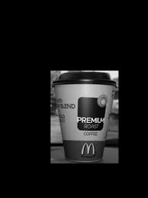
Facts
McDonald’s management requires the coffee to be held at 180 to 190 degreed Fahrenheit.
Liquid at 180 degrees will cause third-degree burns between 3 to 7 seconds.
McDonald’s admitted that they were aware of the risk involved in the hot coffee.
An expert testified that the number of burns were insignificant compared to the number of cups that were sold in a day.
The Supreme Court found out that the company was not taking the reported cases serious.
Testimonies from McDonalds managers showed that the company was to be held reliable.
The court directed the company to compensate Ms. Lebeck an amount of $480,000.
https://encrypted-tbn0.gstatic.com/images?q=tbn%3AANd9GcSnCZ9ODu4Apgeyruc3QF0TloWKoynpafY8RDmCCbUy85vwapBJ&usqp=CAU
Notes:
The juror founds out that McDonald’s was not serious about the already reported cases. They decided that the company was to compensate Ms. Lebeck an amount of $480,000 (Darryl, 2017).

Slide 14
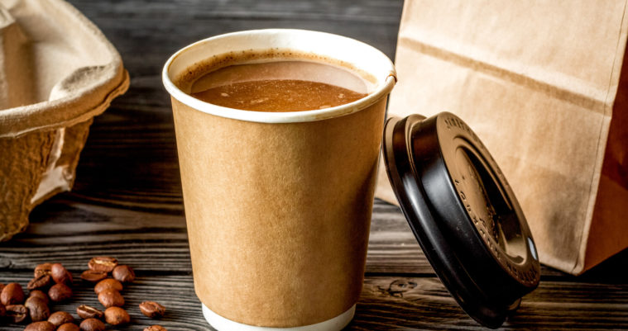
Changes made in the Restaurant after the McDonald’s Hot Coffee Case
Many of the restaurants began to put large warning labels .
The warning labels are stuck on hot beverages.
They act to signal the customers of hot content.
They did not reduce the temperature of their coffee.
The other coffee vendors did not also reduce
The industry is brewing coffee at around 200 degrees Fahrenheit
They sell coffee at around 180 degrees Fahrenheit
https://jpricemcnamara.com/wp-content/uploads/2015/11/Fotolia_176517375_Subscription_Monthly_M-1-759x401.jpg
Notes:
Even after the McDonald’s Coffee case, the coffee vendors seem to have changed slightly. They have resulted to sticking warning labels on the coffee mugs. They have indicated that the contents are hot (Darryl, 2017). However, like for the case of McDonalds, they seem to have maintained the temperature of the coffee that they brew.

Slide 15

Conclusion
McDonald appears not to take the cases seriously.
Prior to the case filed by Ms. Lebeck, there were other 700 similar cases.
Stella Lebeck sustained severe burns after the hot coffee spill over her sweatpants.
The jury decided to have Stella Lebeck compensated by McDonald’s.
They agreed McDonald’s to compensate her $480,000.
McDonalds approached her and they settled a lower amount.
https://images-na.ssl-images-amazon.com/images/I/511jpl2uxNL._SR600%2C315_PIWhiteStrip%2CBottomLeft%2C0%2C35_PIStarRatingFIVE%2CBottomLeft%2C360%2C-6_SR600%2C315_SCLZZZZZZZ_.jpg
Notes:
During the litigation phase, it was found out that there had been around 700 other similar cases reported between 1982 to 1992. however, McDonalds seemed to be not concerned that much since they had done little about it. McDonalds were found guilty and were supposed to compensate Ms. Lebeck $480,000. but, instead they approached her and ended up paying less.

Slide 16

Cont…,
The case involving Ms. Lebeck involved product liability insurance policy.
The policy is concerned with any damages that are caused by the product to the consumer.
The hot coffee had caused severe burns to Ms. Lebeck.
McDonald’s legal team agreed that the company was to reduce the temperature of the coffee pot.
It was later discovered they did not decrease the temperatures.
Instead, they just stuck clear warning to remind the customers that the coffee was hot.
https://pics.loveforquotes.com/the-best-way-to-enjoy-a-morning-coffee-43085857.png
Notes:
The case involved the product liability policy. The policy caters for any damage that is caused to the customers by the products (Daller, 2015). For instance, Ms. Lebeck got compenstated due to the burns that she sustained after the hot coffee spilled over her sweatpants. However, the companies dealing with hot coffee seems not to have changed that much – they have marinated the temperatures of their coffee pots. But, they have stuck warning labels indicating that the contents are hot to act just as a reminder to their customers.

Slide 17
References
Darryl, S. W. (2017). The McDonalds’ Coffee Case. Huffpost, https://www.huffpost.com/entry/the-mcdonalds-coffee-case_b_14002362.
Daller, M. F. (2015). Product liability desk referece 2016 edition. Place of publication not identified: Wolters Kluwer Law.

